Slide 1
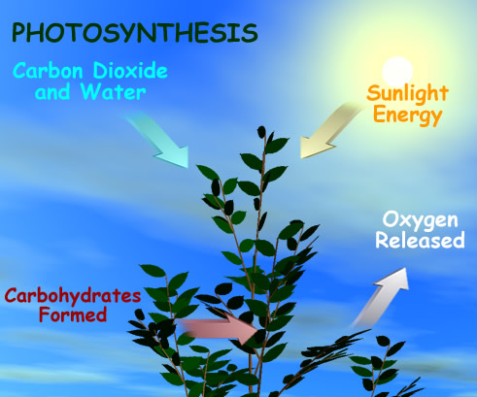

Slide 2
What is visible light?
Electromagnetic radiation of a wavelength that irritates the nervous receptors in the eyes.
ROY G BIV
Primary colors of visible light
Composed of particles of energy called: Photons or Quanta

Slide 3
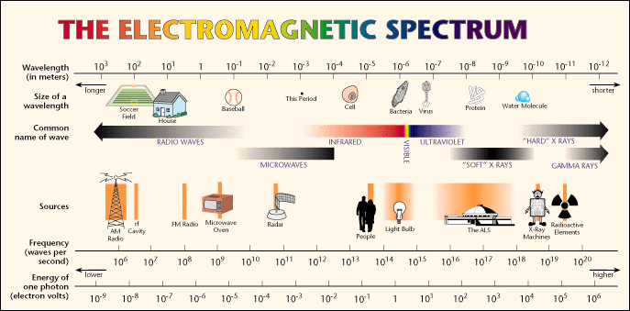

Slide 4
Once a photon of light strikes an object two things happen:
Some of the energy is absorbed.
Some of the energy is reflected.
The absorbed energy is converted to heat or another type of energy
The reflected energy is the color that we see when looking at the object.
Energy Reflected
PHOTON
Energy Absorbed

Slide 5
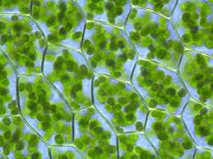
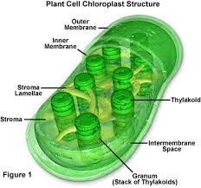
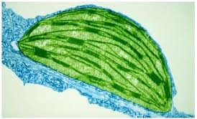
Plant Cells
Micrograph of Chloroplast

Slide 6
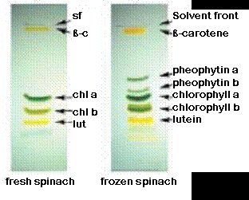
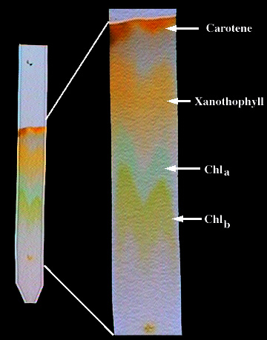
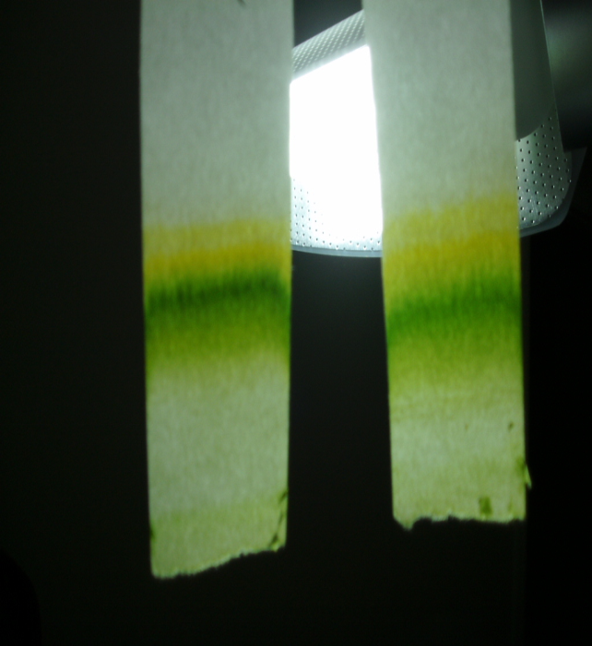
Carotene and Xanthophyll are protective pigments absorbing high energy Blue Light to protect the plant.
Chlorophyll A & B are the photosynthetic pigments absorbing Red Light

Slide 7
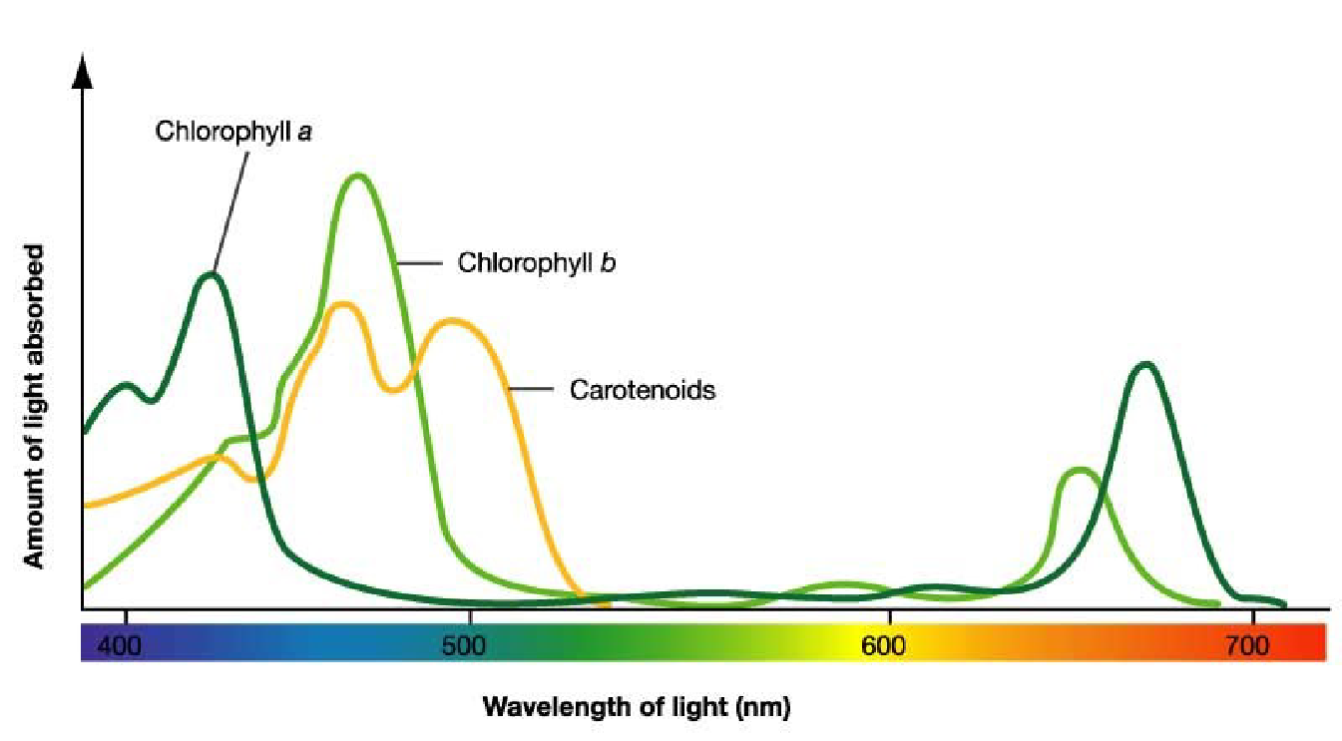
Absorption Spectrum for Pigments

Slide 8
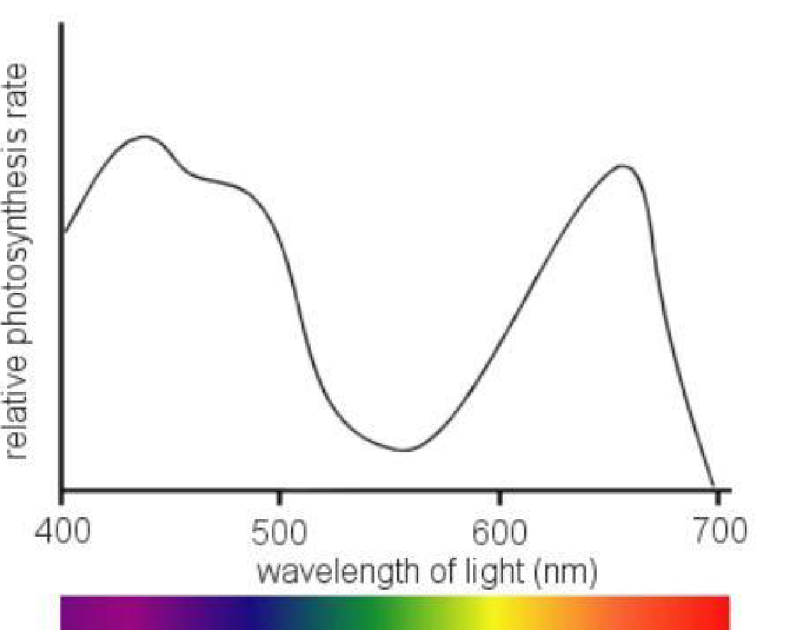
Action Spectrum

Slide 9
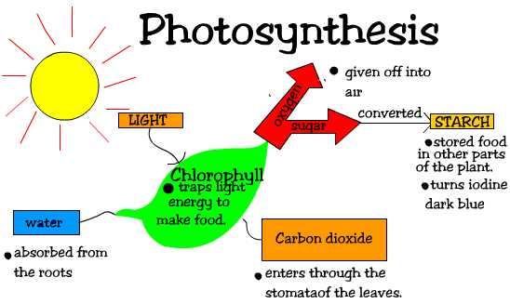
Photosynthesis Video
http://youtu.be/mYbMPwmwx88

Slide 10
Reactions of Photosynthesis
Light Reactions
Photolysis - Non-cyclic Pathway [ H⁺, e⁻, O₂ ]
Photophosphorylation Non-cyclic and Cyclic Pathways [ ADP + P -> ATP ]
Dark Reactions
Calvin – Benson Cycle
Carbon Fixation - Reduction of CO₂ to C₆ H₁₂ O₆

Slide 11
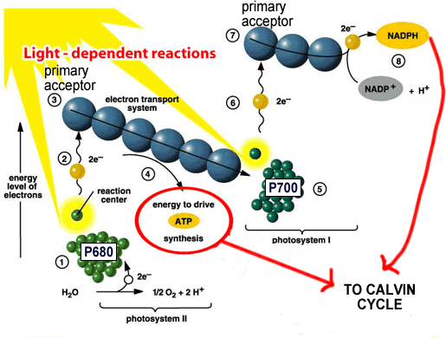

Slide 12
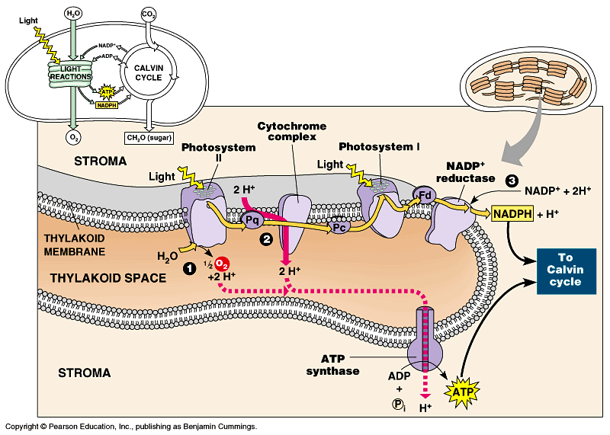

Slide 13
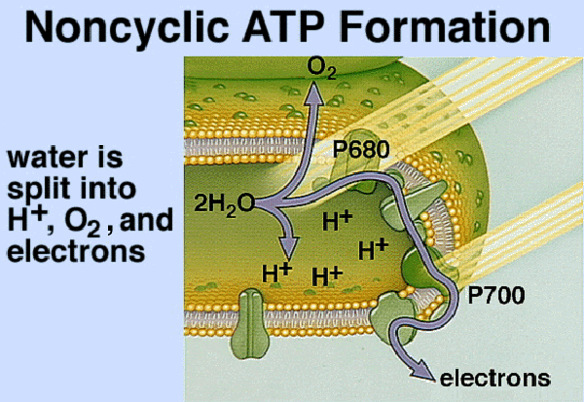

Slide 15
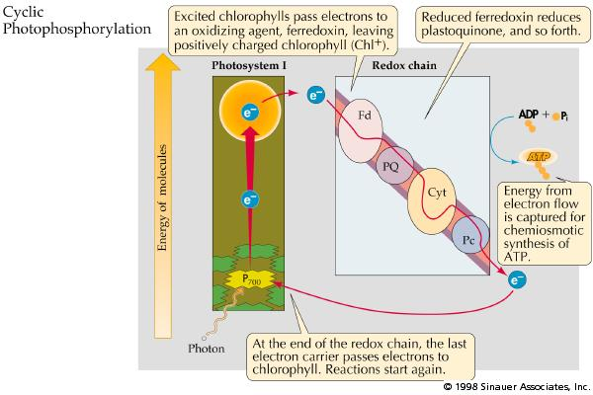

Slide 16
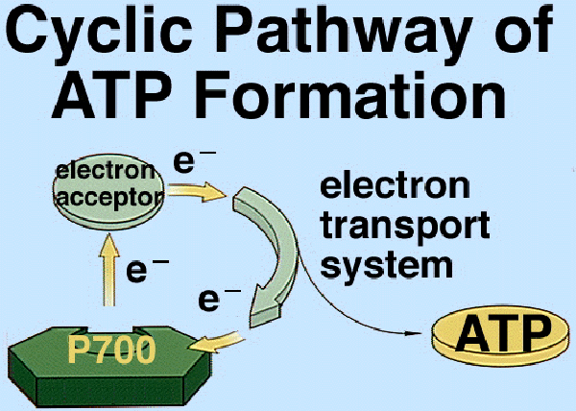

Slide 18
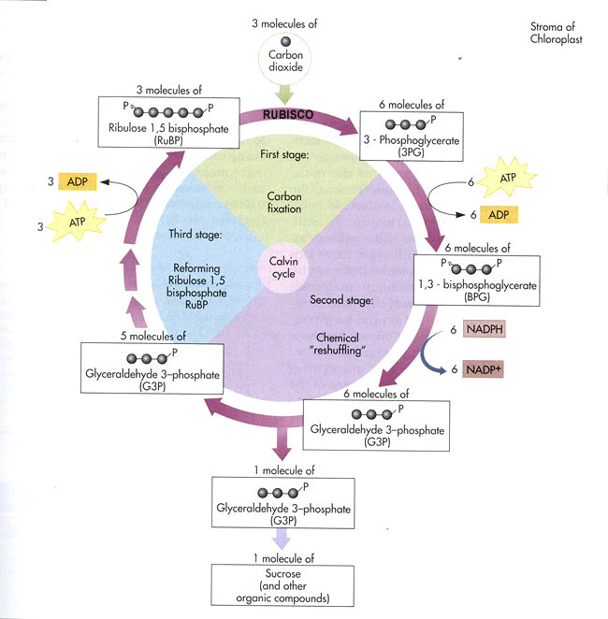

Slide 19
C4 Plants :
sugar cane and corn
crabgrass
Crassulacean Acid Metabolism (CAM)
succulent plants, Cacti, Pineapple

Slide 20
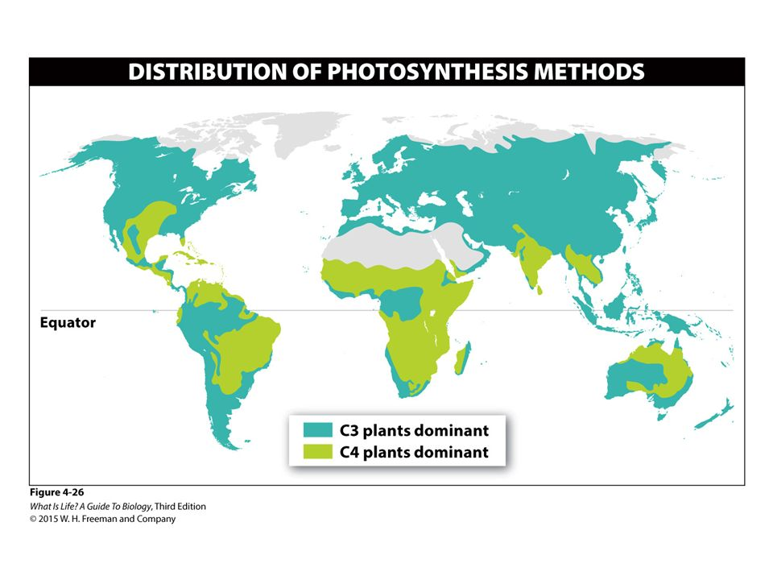
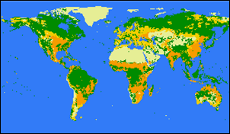
C4 Plants
C4: Orange C3 : Yellow and Green
4 % of Plants are C4 18% of Crops are C4
Evolved from C3 about 25 Million years ago

Slide 21
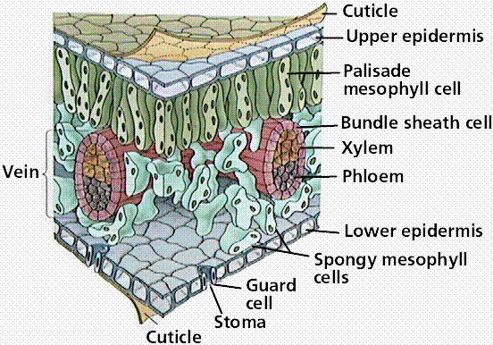
Structure of a Leaf

Slide 22
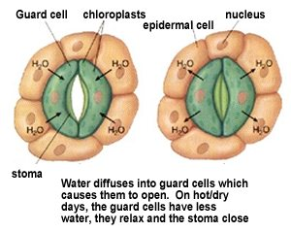
C3 Plants Guard Cells

Slide 23
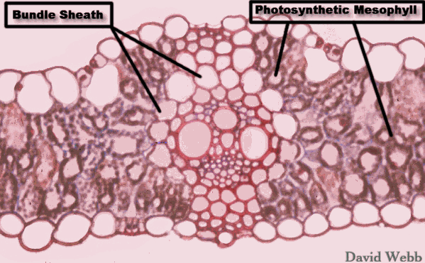
In C3 plants the Bundle Sheath has no Chloroplasts but in C4 plants they do.

Slide 24
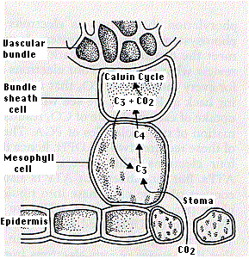

Slide 25
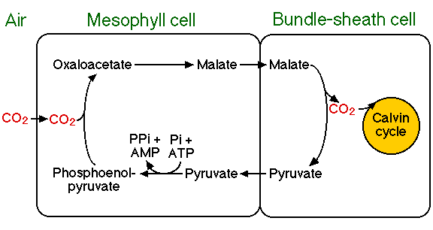
C4 and CAM

Slide 26
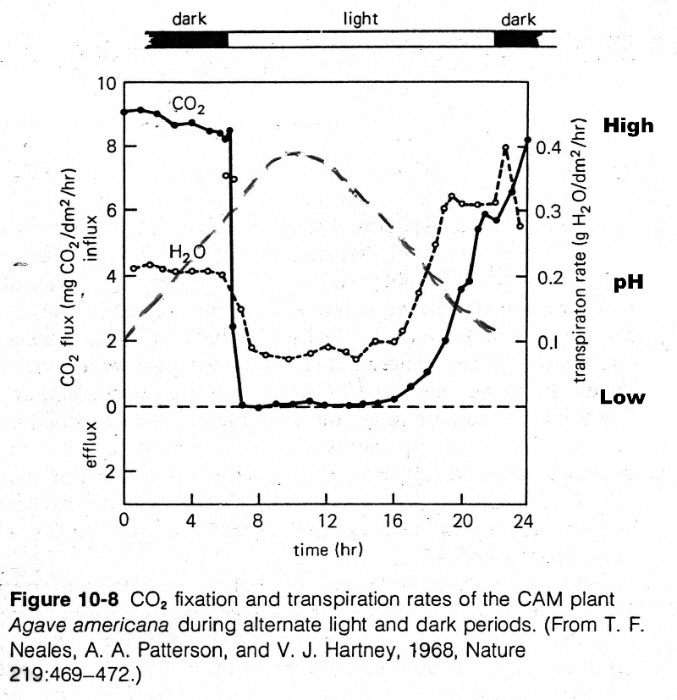

Slide 27
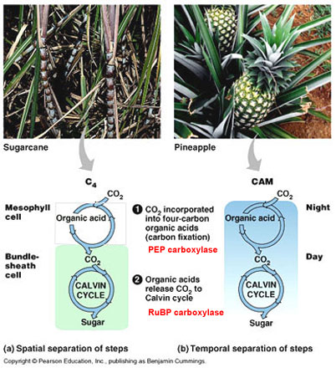

Slide 28
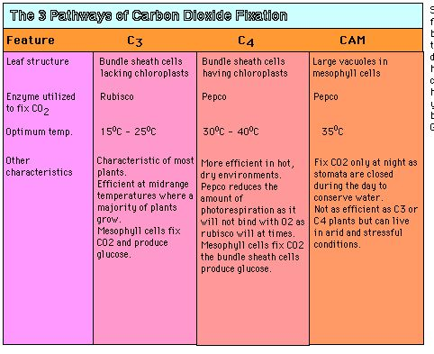

Slide 29
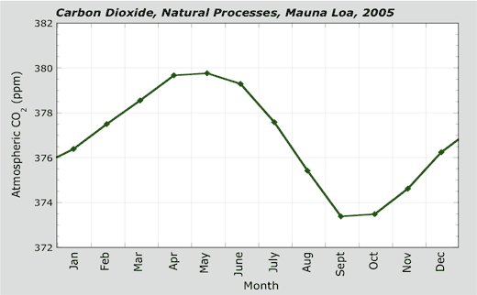
Hit 400 ppm in May 2017. First time in last 10,000 yrs.

Slide 30
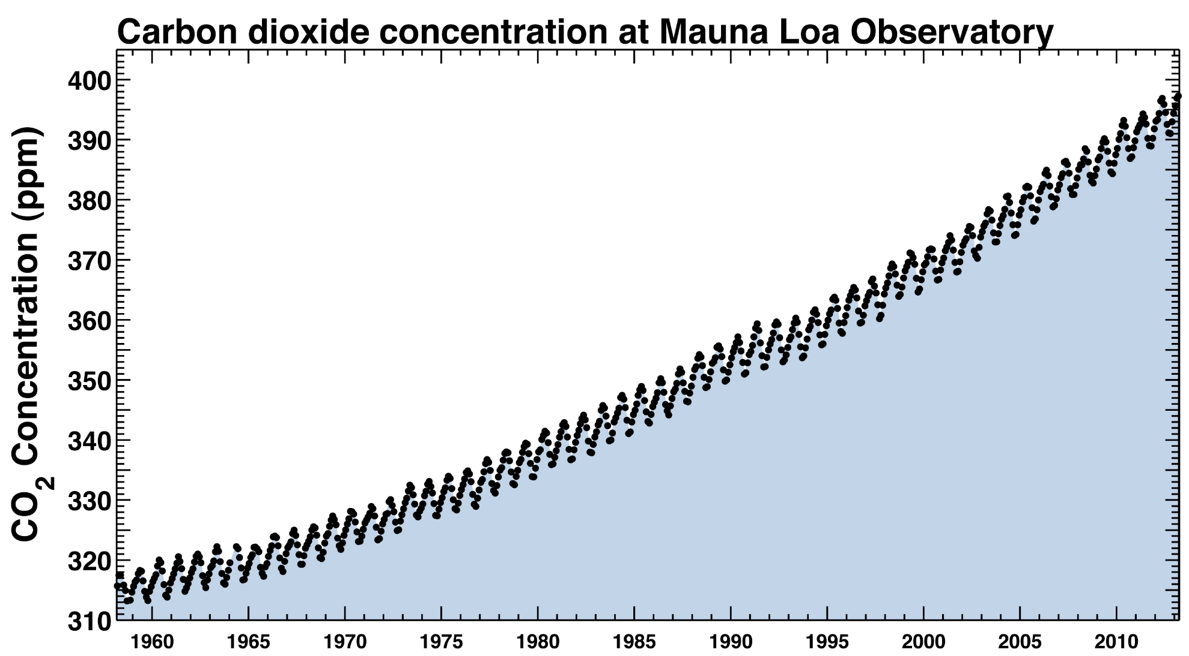

Slide 31
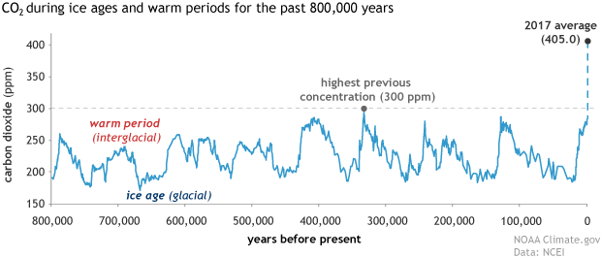

Slide 32
